Slide 1
The Multigenerational Transmission of Social Trauma
Anna Varga, Society for Family Counselors and Therapists, Moscow, Russia Elena Cherepanov, Cambridge College, Boston, USA
EFTA, Athens 2016

Slide 2
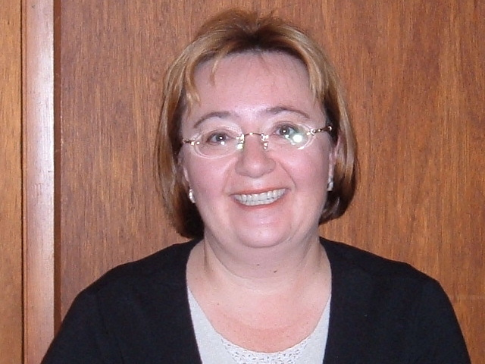
My co-author
Elena Cherepanov, PhD
Cambridge College, Boston, MA USA
Elena.Cherepanov@yahoo.com

Slide 3
The Bowen Theory about social trauma
Social trauma rises anxiety in society
Societal anxiety leaks into family emotional system
Anxiety lowers the level of functioning in both social systems – society and family
The long trauma lowers the level of differentiation in population

Slide 4
Family Systems are traumatized by
dramatic family changes (death, unknown absence, an arrest)
violent change of habitat (forced migration)
long deprivation of basic needs of family members (hunger, poverty, loss of territorial control)
social censure traumatic factor, fear to show the grief

Slide 5
Social traumas in United States of America in XX century
Great Depression 1929-1933. People suffered from hunger. No information how many people died from starvation
World War I – 116 708 dead
Japanese attack on Pearl Harbor – 2403 killed, 1178 injured
World War II – 418 000 dead
The Vietnam War – 58 220 dead
9-11 ( Twin Towers) – 2977 dead

Slide 6
Social traumas in Russia in XX century
World war I – 1,7 million dead
October Revolution and Civil War – 9 million dead
Destruction of the “Kulaks” – 4 million dead
Starvation 1922-1923 -5 million dead
Stalin’s repressions – 5,5 million dead
Forced migration – 1.5 million dead
Starvation 1932-1933 – 7 million dead
World War II – 20 million dead

Slide 7
the number of victims of social disasters of the 20th century
Russia
The United States of America
50 000 000 dead
598 308 dead

Slide 8
Collective trauma inflicted families
Women centered families
People don’t know their ancestry
Emotional fusions and cut-offs as a major pattern of relations
Wide spread of alcoholism and tolerance to alcoholic behavior in society.

Slide 9
How trauma-centered mentality influence generations
Experience of survivor is saved in family in:
memoirs,
behavioral stereotypes,
in rules how to react emotionally on different events,
in proverbs and survival messages

Slide 10
How trauma-centered mentality influence generations
Survival mode is the way of functioning where an individual strives to accomplish immediate survivor tasks. In short run it is effective.
It is maladaptive and interfere with long-term post-trauma adjustment.
Family desire to protect progenies from a similar pain and fate and to increase their chances to survive.
This shapes the transgenerational aspect of survivorship, that is, when a female victim of abuse teaches her daughter never to trust men.

Slide 11
Study of survival messages in two cultures
This is a pilot study.
We investigate the difference between survival messages in two cultures – trauma centric Russia and non-trauma centric USA.
Sample: 22 Russian and 23 American postgraduate students
Questionnaire about family survival messages.

Slide 12
Examples of survey questions
What is the most important experience of survival has been in your family?
What helped overcome adversity?
What should I avoid? Who should avoid?
What is said about the meaning of suffering?
The requirements regarding food?
Regulations on how to interact with the authorities in the lurch?

Slide 13
Data processing
сounted the amount of text when answering each question of the questionnaire. It was an indirect indicator of the significance of the issue
conducted content analysis of the answers

Slide 14
The template for content analysis
Prescriptions about skills and abilities. (i.e. regulations about education, profession, prescriptions on how to solve problems)
Regulations about the tools of survival (i.e.to save, stock up and preserve, to make plans/don’t make plans)
Prescriptions about how to treat the difficulties (to avoid , to prepare for trouble in advance)
Regulations on where to look for sources of strength, resources (faith, hope, positive outlook, to work hard…)

Slide 15
The template for content analysis
The sources of support (family, friends..)
Messages generated by traumatic experience (don’t hope, don’t trust the state of the authorities, strangers, don't ask for help; rely on yourself don't show weakness and fear)
Regulations on the behavior, actions how to be safe, what to avoid, the value of compassion and helping other people

Slide 16
Results: the amount of text

Slide 17
Results: content analysis, general categories

Slide 18
Results: content analysis. Prescriptions about skills and abilities.

Slide 19
Results: content analysis. Regulations about the tools of survival

Slide 20
Results: content analysis. Where to look for sources of strength

Slide 21
Results: content analysis. The sources of support

Slide 22
Content Analysis. Messages generated by traumatic experience

Slide 23
Results
Main differences:
Non trauma centric Society: Pro-social orientation, trust people, ask for help, help others, be ethical, be social competent, be professional.
Trauma centric Society: no one to trust, no one to help, to rely on themselves and their families, to their own spirituality, to hoard, to stock, to be able to solve problems. There is no regulation about the ethics, about the value of the profession and pro-social orientation.

Slide 24
Family level of differentiation lowered by social traumas

Slide 25
Family which level of differentiation was not influenced by social traumas

Slide 26
Thank you!
Anna Varga,Ph.D, Society for Family Counselors and Psychotherapists, the Head of Masters Programme on Systemic Family Therapy Psychological Department of High School of Economy, Moscow, Russia
avarga@yandex.ru

